Slide 1
Ring Spectrum
輸入0dBm
輸入10dBm

Slide 2
MRM nonlinear spectrum 8 dBm

Slide 3
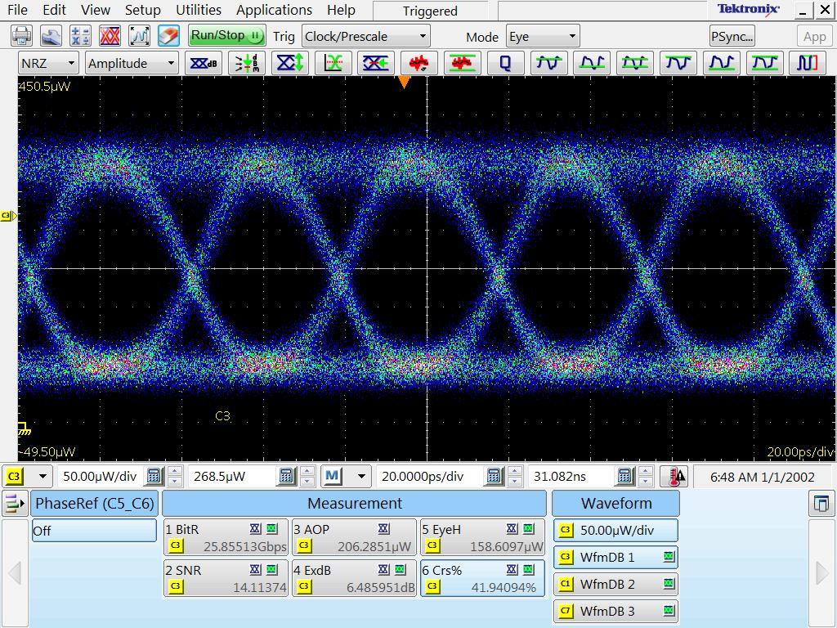
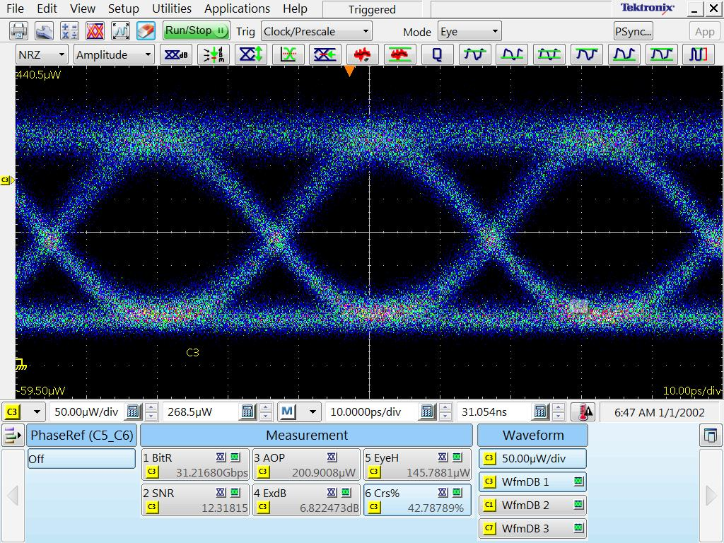
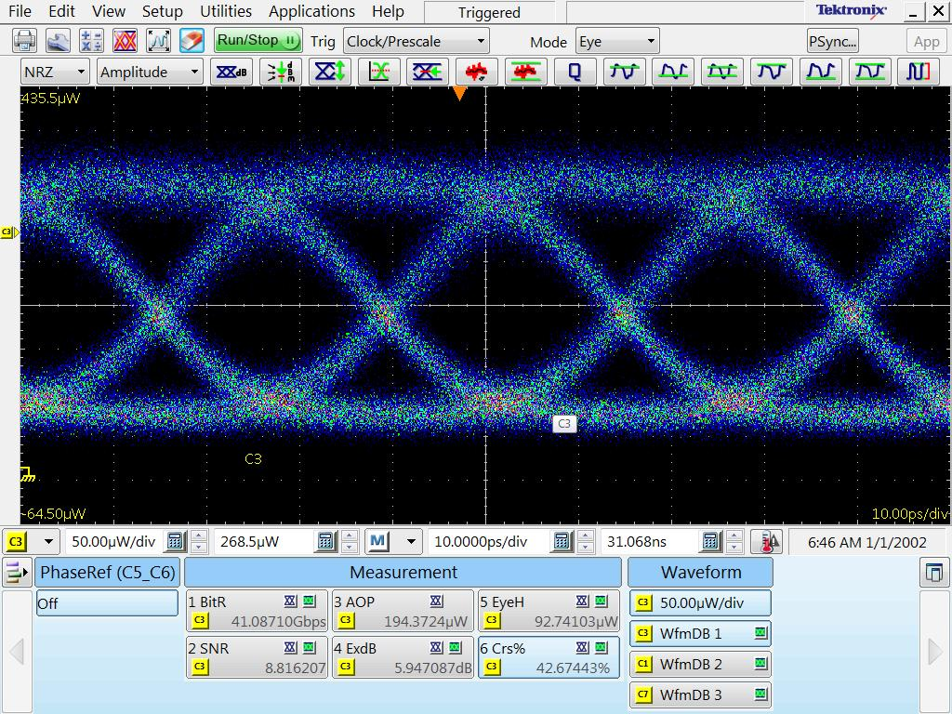
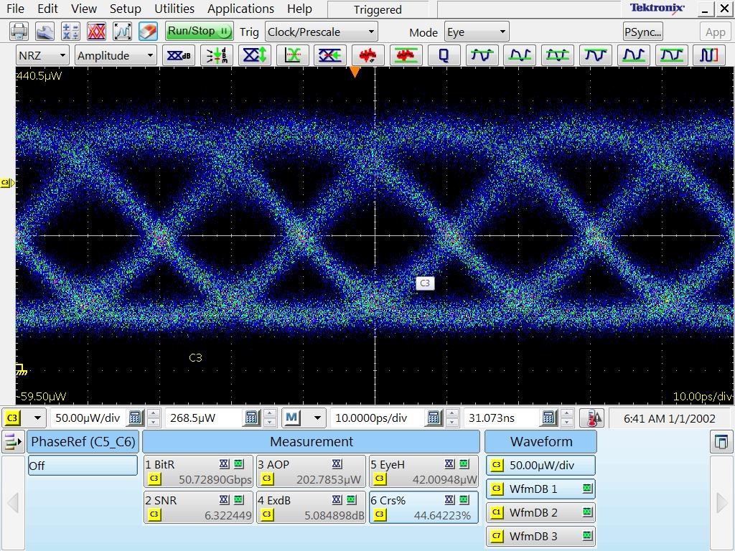
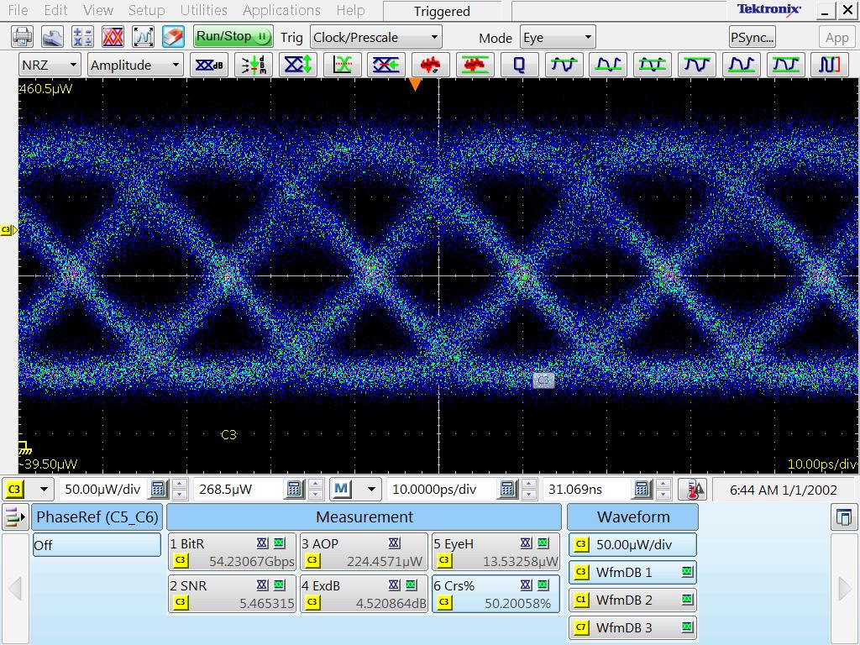
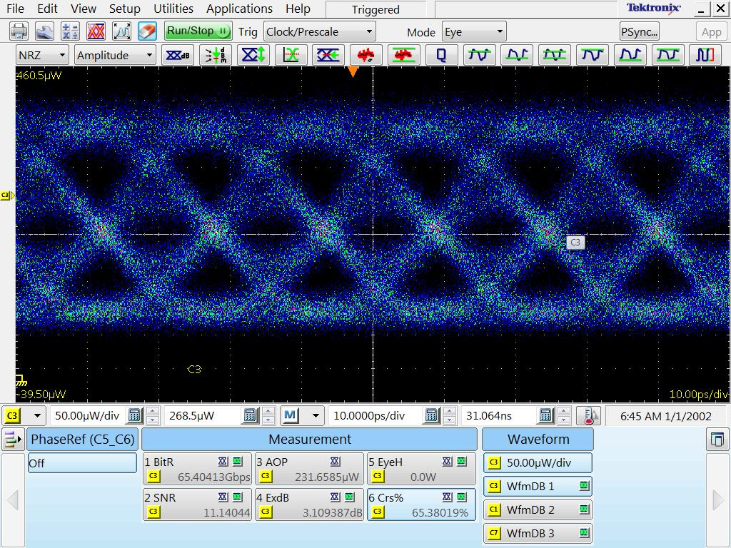
MRM nonlinear Eye-diagram
DC: -3V Vpp: 1.6V Input: 8dBm
26.5Gbit/s NRZ
32Gbit/s NRZ
40Gbit/s NRZ
50Gbit/s NRZ
56Gbit/s NRZ
64Gbit/s NRZ

Slide 4
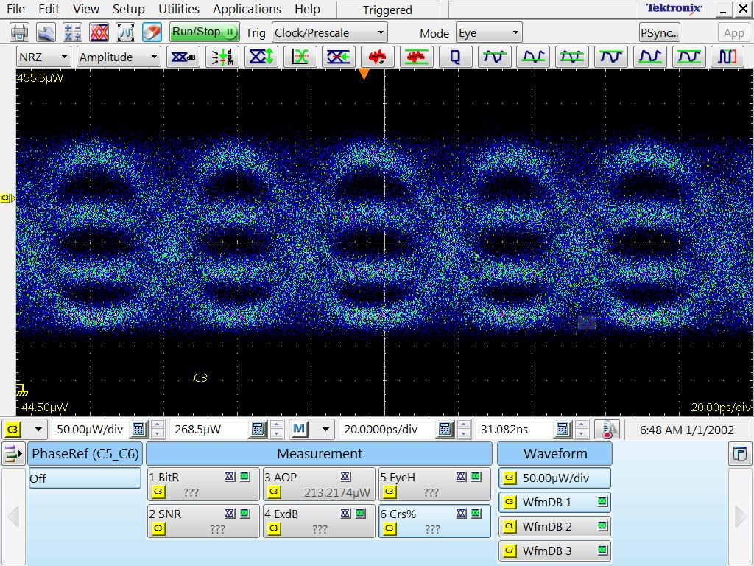
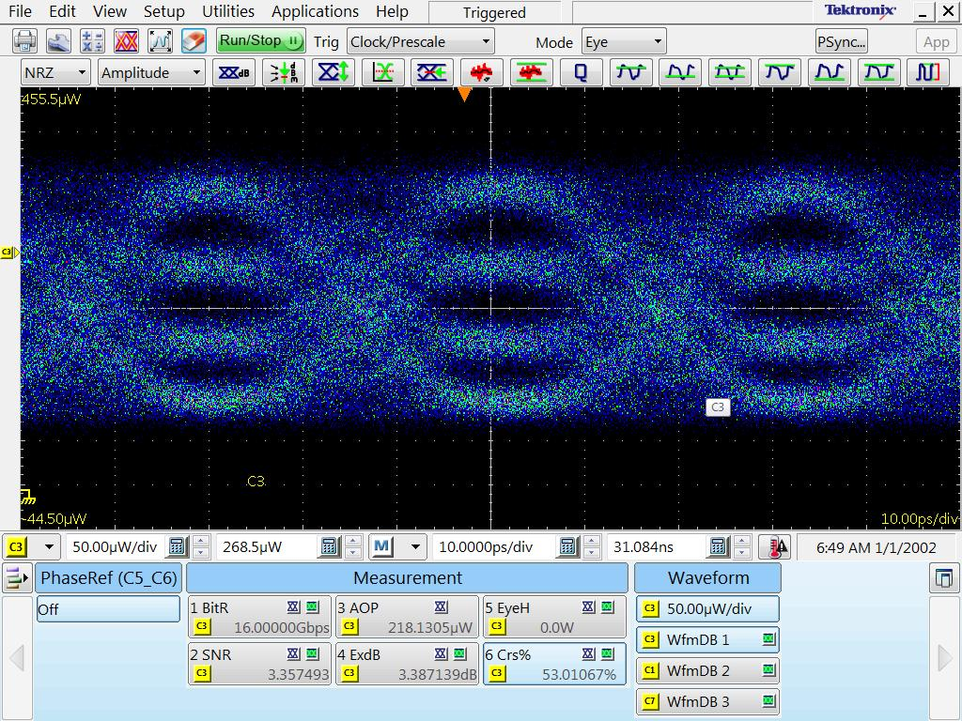
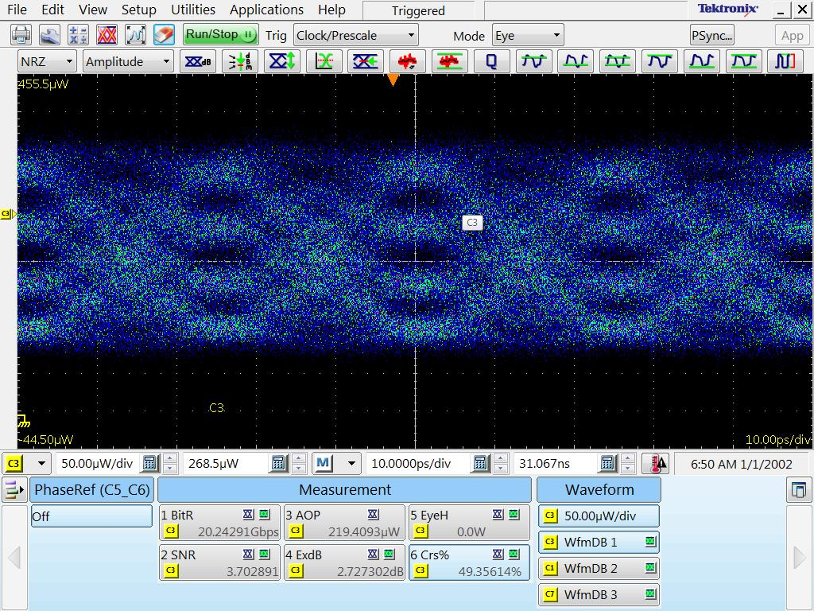
MRM nonlinear Eye-diagram
DC: -3V Vpp: 1.6V Input: 8dBm
26.5Gaud/s PAM4
32Gaud/s PAM4
40Gaud/s PAM4

